Slide 1

LANGUAGE FOCUS

Slide 2

UNIT2 : LANGUAGE FOCUS
I/ The present perfect
recently
for
Adverbs used with
the present perfect
ever
since
yet
already
Form : Have/Has + V3/V(ed)….

Slide 3
UNIT2 : LANGUAGE FOCUS
I/ The present perfect
Form : Have/Has + V3/V(ed)….
Nam
Nga
1.Work with a partner. Read the dialogue:
Nga: Come and see my photo album.
Nam: Lovely! Who’s this girl?
Nga: Ah! It’s Lan, my old friend.
Nam: How long have you made friends with her?
Nga: I’ve made friends with her for six years.
Nam: Have you seen her recently?
Nga: No, I haven’t seen her since 2003.
Quang – brother’s friend / seven months /January
Hoa – new friend / three weeks / Monday

Slide 4
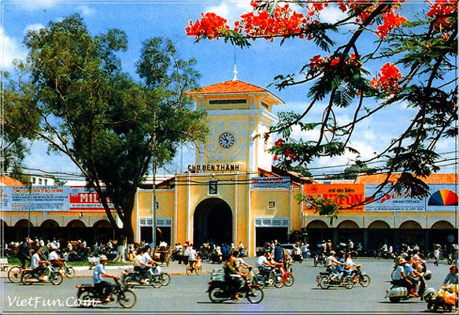
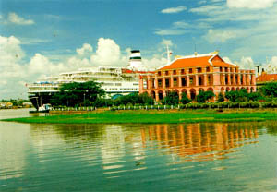
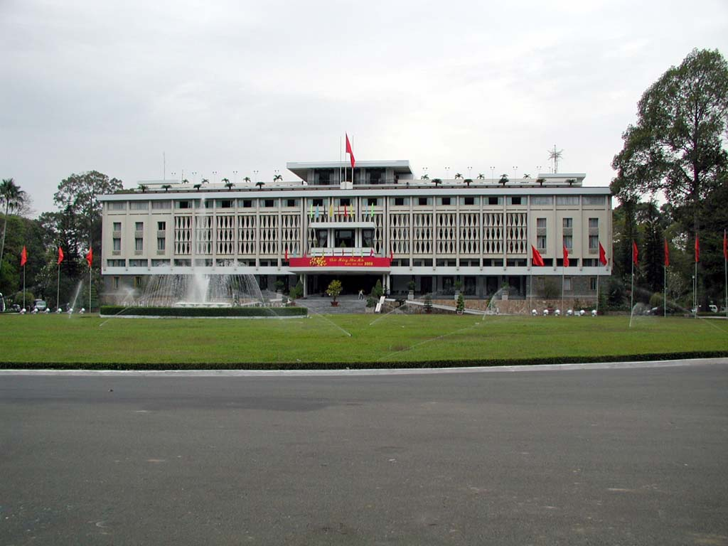
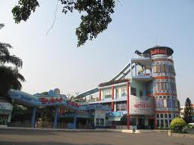
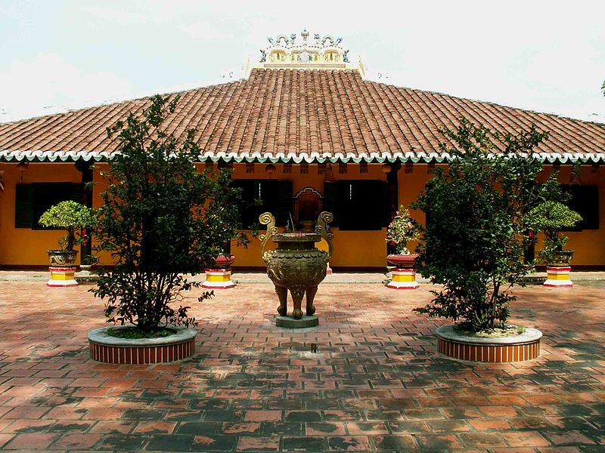
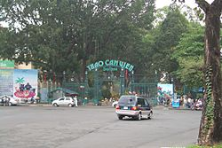
* SOME FAMOUS PLACES IN HO CHI MINH CITY:
UNIT2 : LANGUAGE FOCUS
Nha Rong harbor
Reunification palace
Ben Thanh Market
Dam Sen Amusement Park
Giac Lam Pogoda
Zoo and Botanical Gardens

Slide 5


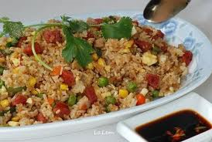

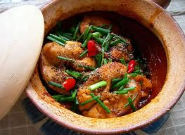
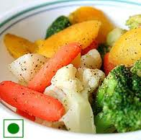
UNIT2 : LANGUAGE FOCUS
2/
Do visit see go eat
Sights
Food
Giac Lam Pagoda.
Reunification Palace
French food
Chinese food
Dam Sen
Amusement Park
Zoo and Botanical
Gardens
Vietnamese food
vegetarian
Have you seen Giac Lam Pagoda ?
Yes ,I’ve already seen it
Have you eaten Vietnamese food yet?
No,I haven’t

Slide 6
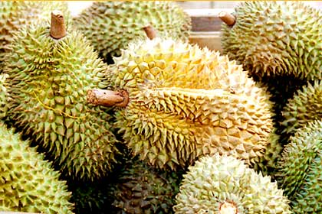
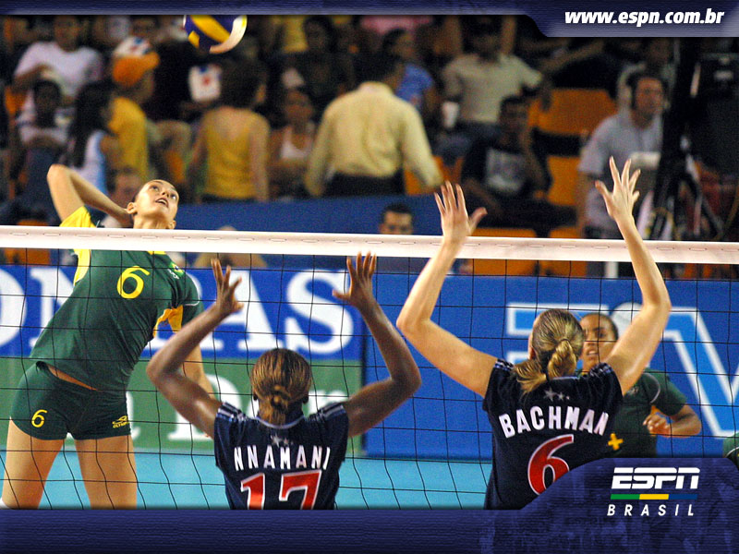
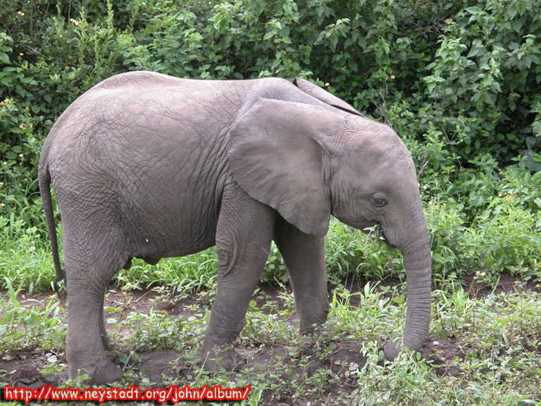

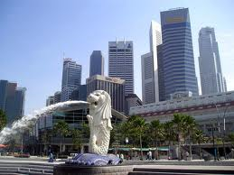
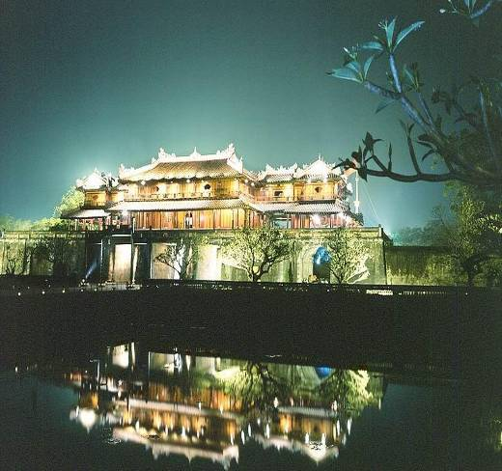
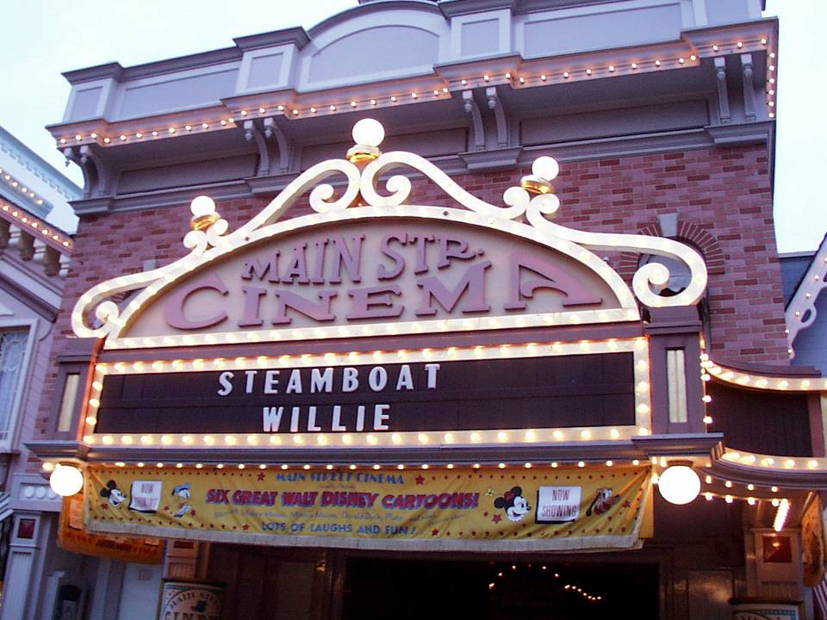
3/ Work with a partner .Ask and answer questions about each sights
Nam: Have you ever gone to Hue?
Nga: Yes, I have.
Nam: When did you last go to Hue?
Nga: Last year.
Nam
-Nam: Have you ever been to Singapore
Nga: No, I haven’t.
Nga

Slide 7
UNIT2 : LANGUAGE FOCUS
II.The passive voice
1/ Simple present tense.
Active : S + Vs/ es + O ………
Passive: → S + is / are / am + V3/( ed )+ (by O)
2/ Simple past tense.
Active : S + Ved/ V2 + O ………
Passive: → S + was/were + V3( ed ) + (by O)
3/ Present perfect tense
Active : S + have / has +V3(ed) + O ………
Passive: → S + have /has + been + V3( ed )+ (by O)
4/Modal Verbs, Have to, Be going to:
.
Active : S + MD + V (inf) + O ………
Passive: → S + MD + be + V3( ed )+ (by O)

Slide 8
4,5/ Change these sentences into the passive voice, as directed:
a. They made jean cloth completely from cotton in the 18th century.
- Jean cloth
b. They grow rice in tropical countries.
- Rice
c. They will produce five million bottles of champagne in France next year.
- Five million bottles of champagne
d. They have just introduced a new style of jeans in the USA
- A new style of jeans
e. We can solve the problem.
-
f. We have to improve all the schools in the city.
- g. They are going to build a new bridge.
-
was made completely from cotton in the 18th century
is grown in tropical country
will be produced in France next year.
has just been introduced in the USA
The problem can be solved by us.
All the schools in the city have to be improved
A new bridge is going to be built

Slide 9
II. Homework:
Use the correct form of the verbs:
I (learn) English for 4 years.
They (live) in Danang since 2001
You (eat) Chinese food yet?
Life on another planet might (find)
Two department stores (build) next year.
2.Do all exercises (1-2-3-4-5) on pages 19 – 21 again
3. Prepare unit 3 – Getting started – Listen & read

